Slide 1
Database Systems
Lab 09
PHP with MYSQL
JAVA with MYSQL

Slide 2
All in ONE
Web Server - XAMPP - APACHE
PHP – (7.1.10: LATEST)
Database ( MY-SQL)
Text Editor ( Notepad++ , PHPSTORM ,NetBeans for Java etc)
JDBC driver for Java and MySQL Connection
Web browser (CHROME, Internet Explorer, etc)

Slide 3
MySQL?
MySQL is a database system used on the web
MySQL is a database system that runs on a server
MySQL is ideal for both small and large applications
MySQL is very fast, reliable, and easy to use
MySQL uses standard SQL
MySQL compiles on a number of platforms
MySQL is free to download and use
MySQL is developed, distributed, and supported by Oracle Corporation

Slide 4
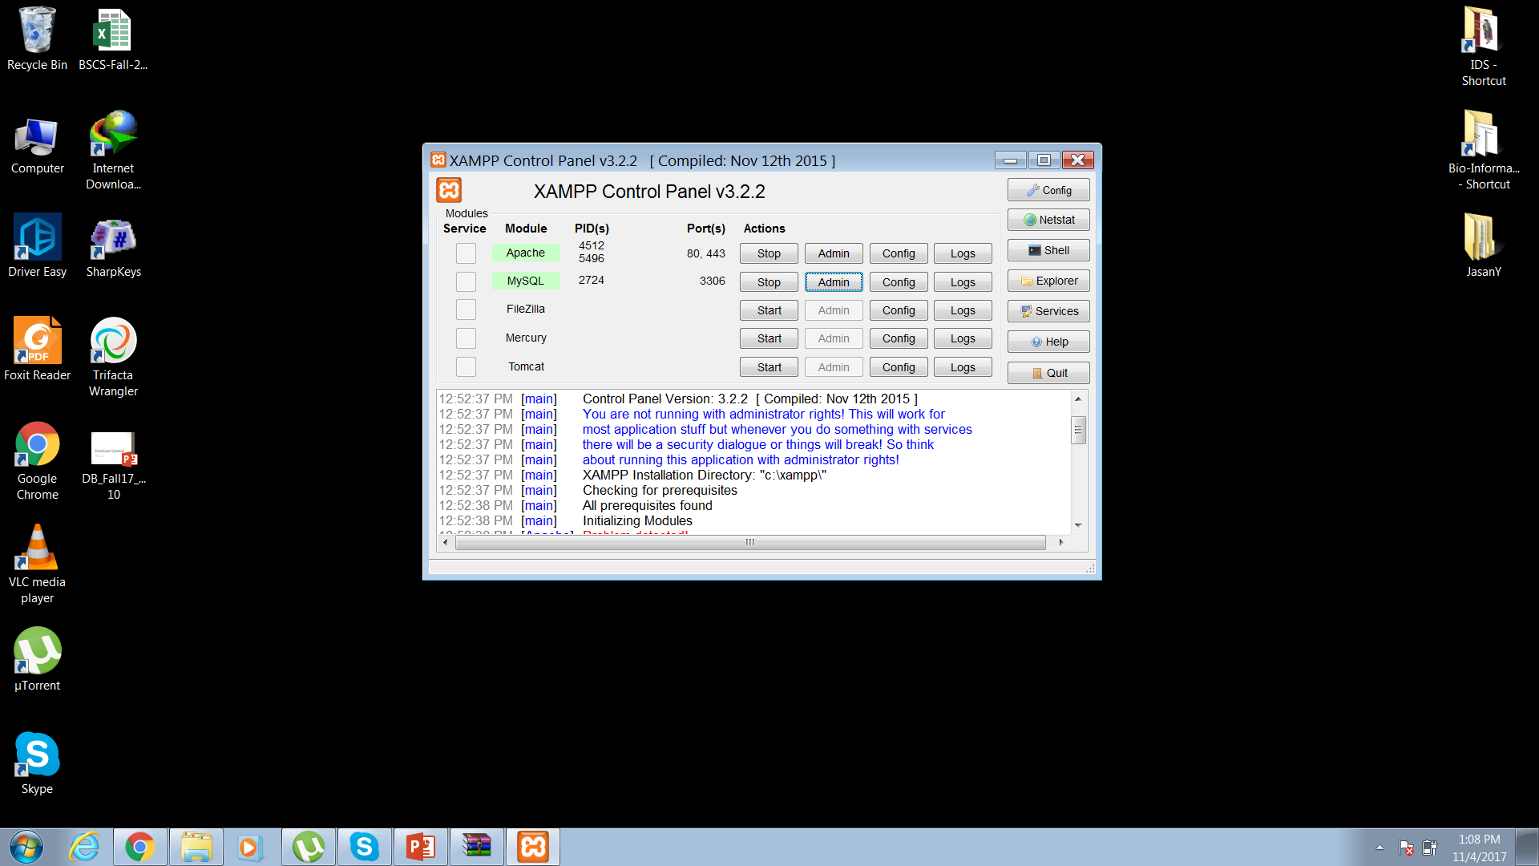
XAMPP – Control Panel

Slide 5
PHP Connection to MYSQL
Before we can access data in the MySQL database, we need to be able to connect to the server
<?php
$servername = "localhost";
$username = "root";
//$password = "password";
// Create connection
$conn = mysqli_connect($servername, $username);
// Check connection
if (!$conn) {
die("Connection failed: " . mysqli_connect_error());
}
echo "Connected successfully";
?>

Slide 6
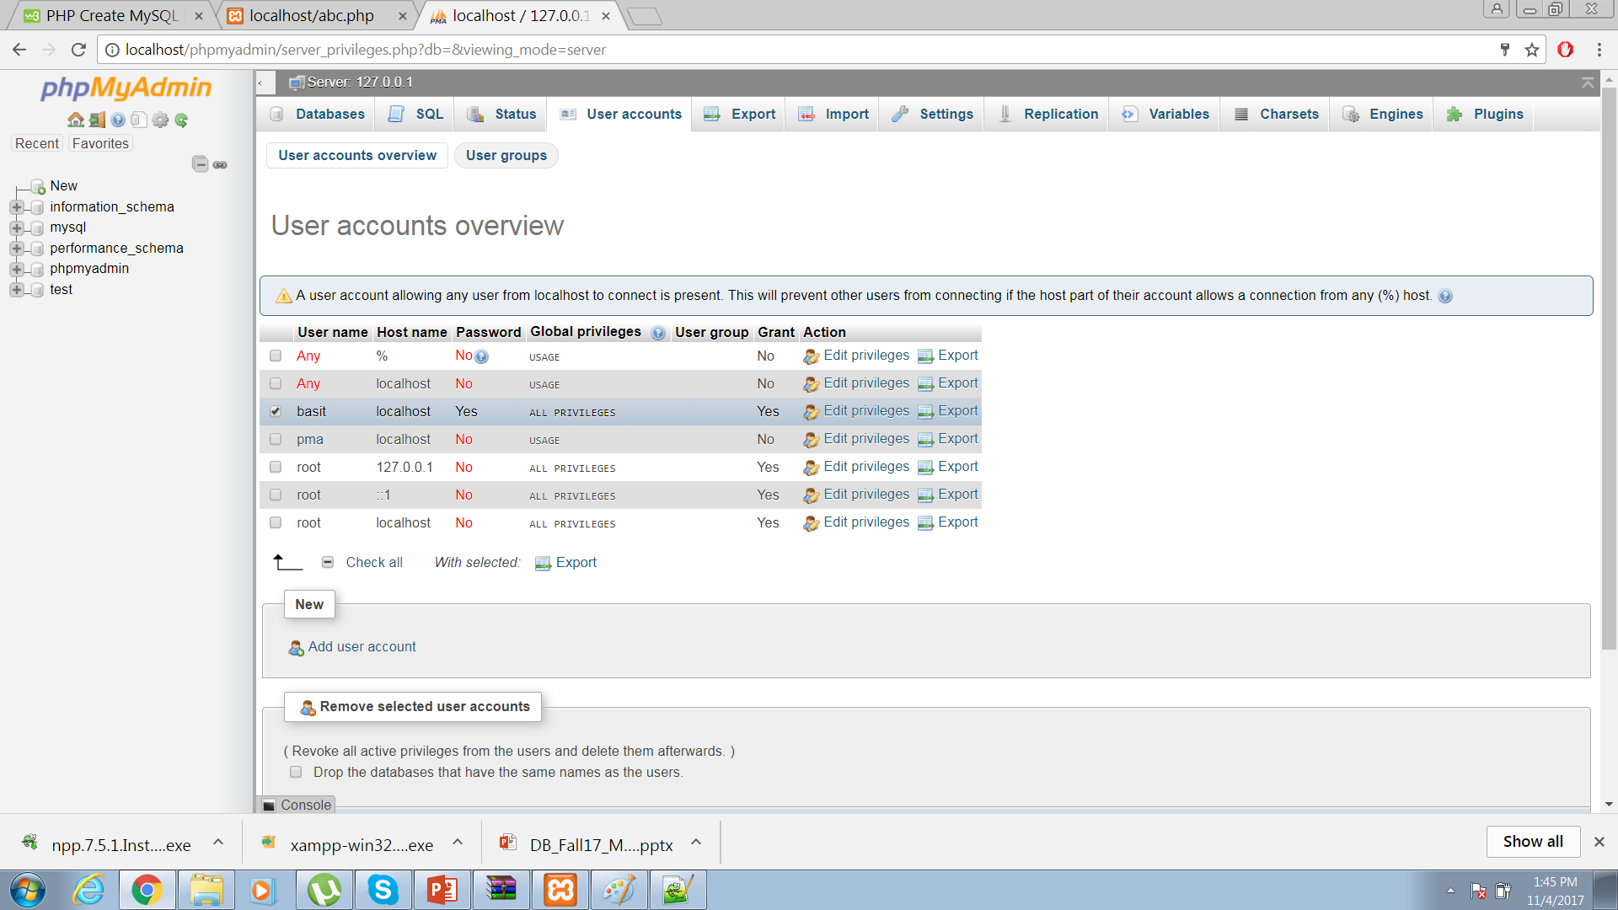
Users? Username? Hostname?

Slide 7
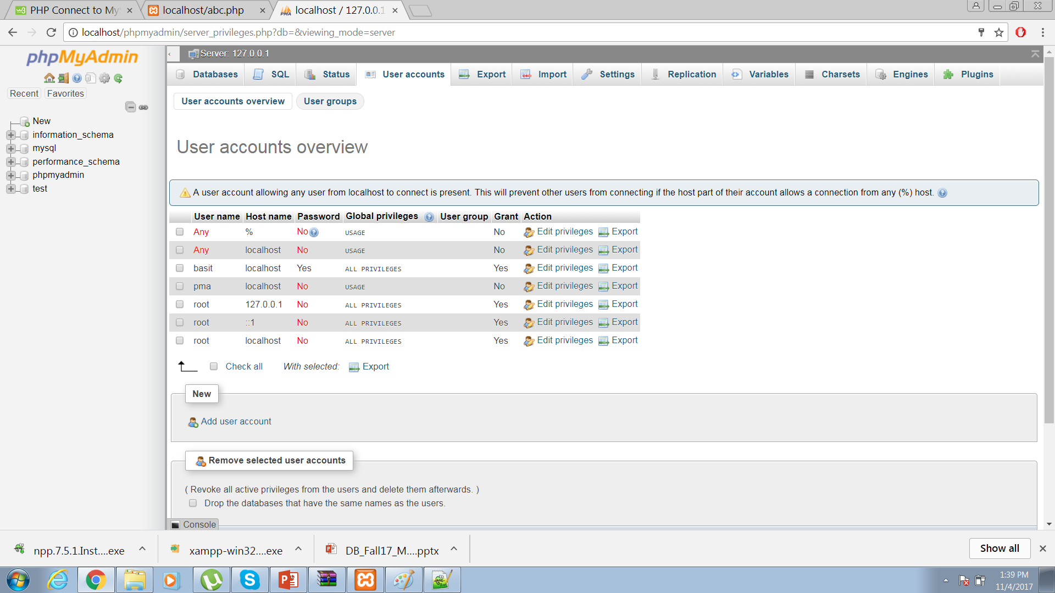
User Added

Slide 8
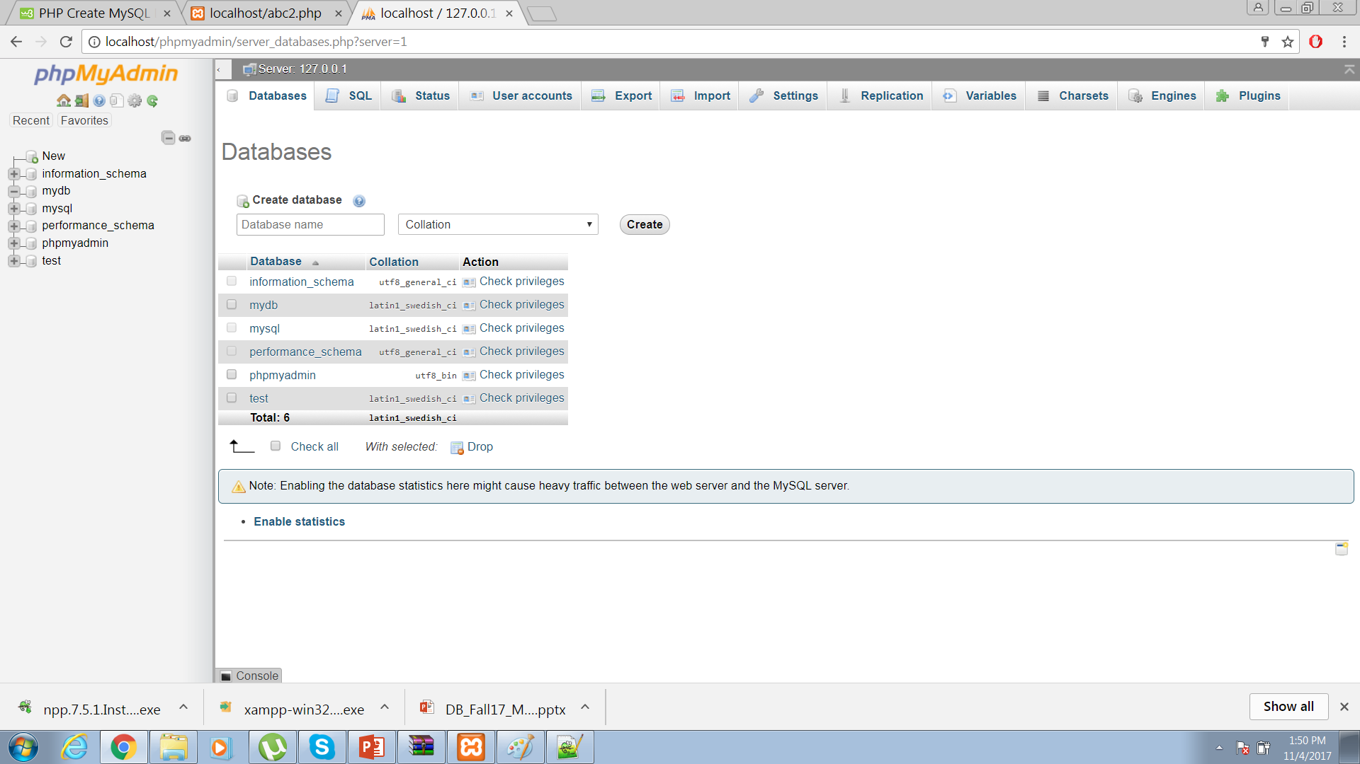
Creating Database
Two ways
1 – Directly on phpadmin console.
2 - Front end (Text editor)
1

Slide 9
2
<?php
$servername = "localhost";
$username = "basit";
$password = "abc123123";
// Create connection
$conn = new mysqli($servername, $username, $password);
// Check connection
if ($conn->connect_error) {
die("Connection failed: " . $conn->connect_error);
}
// Create database
$sql = "CREATE DATABASE myDB";
if ($conn->query($sql) === TRUE) {
echo "Database created successfully";
} else {
echo "Error creating database: " . $conn->error;
}
$conn->close();
?>

Slide 10
1
CREATE TABLE MyGuests ( id INT(6) UNSIGNED AUTO_INCREMENT PRIMARY KEY, firstname VARCHAR(30) NOT NULL, lastname VARCHAR(30) NOT NULL, email VARCHAR(50), reg_date TIMESTAMP )

Slide 11
2
<?php
$servername = "localhost";
$username = "basit";
$password = "abc123123";
$dbname = "myDB";
// Create connection
$conn = new mysqli($servername, $username, $password, $dbname);
// Check connection
if ($conn->connect_error) {
die("Connection failed: " . $conn->connect_error);
}
// sql to create table
$sql = "CREATE TABLE MyGuests (
id INT(6) UNSIGNED AUTO_INCREMENT PRIMARY KEY,
firstname VARCHAR(30) NOT NULL,
lastname VARCHAR(30) NOT NULL,
email VARCHAR(50),
reg_date TIMESTAMP
)";
if ($conn->query($sql) === TRUE) {
echo "Table MyGuests created successfully";
} else {
echo "Error creating table: " . $conn->error;
}
$conn->close();
?>

Slide 12
Inserting data into table
<?php
$servername = "localhost";
$username = "basit";
$password = "abc123123";
// Create connection $conn = new mysqli($servername, $username, $password, $dbname); // Check connection if ($conn->connect_error) { die("Connection failed: " . $conn->connect_error); } $sql = "INSERT INTO MyGuests (firstname, lastname, email) VALUES ('John', 'Doe', 'john@example.com')"; if ($conn->query($sql) === TRUE) { echo "New record created successfully"; } else { echo "Error: " . $sql . "<br>" . $conn->error; } $conn->close(); ?>

Slide 13
Inserting multiple records
<?php
$servername = "localhost";
$username = "basit";
$password = "abc123123";
$dbname = "myDB";
// Create connection
$conn = new mysqli($servername, $username, $password, $dbname);
// Check connection
if ($conn->connect_error) {
die("Connection failed: " . $conn->connect_error);
}
$sql = "INSERT INTO MyGuests (firstname, lastname, email)
VALUES ('John', 'Doe', 'john@example.com');";
$sql .= "INSERT INTO MyGuests (firstname, lastname, email)
VALUES ('Mary', 'Moe', 'mary@example.com');";
$sql .= "INSERT INTO MyGuests (firstname, lastname, email)
VALUES ('Julie', 'Dooley', 'julie@example.com')";
if ($conn->multi_query($sql) === TRUE) {
echo "New records created successfully";
} else {
echo "Error: " . $sql . "<br>" . $conn->error;
}
$conn->close();
?>

Slide 14
Prepared Statements and Bound Parameters
A prepared statement is a feature used to execute the same (or similar) SQL statements repeatedly with high efficiency.
Prepared statements basically work like this:
Prepare: An SQL statement template is created and sent to the database. Certain values are left unspecified, called parameters (labeled "?"). Example: INSERT INTO MyGuests VALUES(?, ?, ?)
The database parses, compiles, and performs query optimization on the SQL statement template, and stores the result without executing it
Execute: At a later time, the application binds the values to the parameters, and the database executes the statement. The application may execute the statement as many times as it wants with different values

Slide 15
Example
<?php
$servername = "localhost";
$username = "basit";
$password = "abc123123"; $dbname = "myDB"; // Create connection $conn = new mysqli($servername, $username, $password, $dbname); // Check connection if ($conn->connect_error) { die("Connection failed: " . $conn->connect_error); } // prepare and bind $stmt = $conn->prepare("INSERT INTO MyGuests (firstname, lastname, email) VALUES (?, ?, ?)"); $stmt->bind_param("sss", $firstname, $lastname, $email); // set parameters and execute $firstname = "John"; $lastname = "Doe"; $email = "john@example.com"; $stmt->execute(); $firstname = "Mary"; $lastname = "Moe"; $email = "mary@example.com"; $stmt->execute(); $firstname = "Julie"; $lastname = "Dooley"; $email = "julie@example.com"; $stmt->execute(); echo "New records created successfully"; $stmt->close(); $conn->close(); ?>

Slide 16
Selecting Data
<?php
$servername = "localhost";
$username = "basit";
$password = "abc123123";
$dbname = "myDB"; // Create connection $conn = new mysqli($servername, $username, $password, $dbname); // Check connection if ($conn->connect_error) { die("Connection failed: " . $conn->connect_error); } $sql = "SELECT id, firstname, lastname FROM MyGuests"; $result = $conn->query($sql); if ($result->num_rows > 0) { // output data of each row while($row = $result->fetch_assoc()) { echo "id: " . $row["id"]. " - Name: " . $row["firstname"]. " " . $row["lastname"]. "<br>"; } } else { echo "0 results"; } $conn->close(); ?>

Slide 17
Deleting Data
<?php
$servername = "localhost";
$username = "basit";
$password = "abc123123";
$dbname = "myDB"; // Create connection $conn = new mysqli($servername, $username, $password, $dbname); // Check connection if ($conn->connect_error) { die("Connection failed: " . $conn->connect_error); } // sql to delete a record $sql = "DELETE FROM MyGuests WHERE id=3"; if ($conn->query($sql) === TRUE) { echo "Record deleted successfully"; } else { echo "Error deleting record: " . $conn->error; } $conn->close(); ?>

Slide 18
Updating Data
<?php
$servername = "localhost";
$username = "basit";
$password = "abc123123"; $dbname = "myDB"; // Create connection $conn = new mysqli($servername, $username, $password, $dbname); // Check connection if ($conn->connect_error) { die("Connection failed: " . $conn->connect_error); } $sql = "UPDATE MyGuests SET lastname='Doe' WHERE id=2"; if ($conn->query($sql) === TRUE) { echo "Record updated successfully"; } else { echo "Error updating record: " . $conn->error; } $conn->close(); ?>

Slide 19
Transaction
Transactions are an important feature of many applications. (For the beginner, transactions are where you want to have a number of queries that either fail or succeed together. The classic example is a bank transaction. Money comes off your account into someone else's, and if either transaction fails, they must both fail.)
Transactions can be tricky to manage on a code level. Constant error checking is required to determine whether to COMMIT (the transactions have all succeeded, and are finalized), or ROLLBACK (one or more transactions have failed, and the entire lot must be reversed).

Slide 20
Transaction
Two ways to handle.
1) Transaction handling yourself by using BeginTrans(), CommitTrans() and RollbackTrans functions
2) By using some useful functions that make transaction handling painless like StartTrans() and CompleteTrans() will automatically handle errors, performing a COMMIT or ROLLBACK as appropriate.

Slide 21
Transactions – 1st Method
try {
/* switch autocommit status to FALSE. Actually, it starts transaction */
$conn->autocommit(FALSE);
$res = $conn->query($sql1);
if($res === false) {
throw new Exception('Wrong SQL: ' . $sql . ' Error: ' . $conn->error);
}
$res = $conn->query($sql2);
if($res === false) {
throw new Exception('Wrong SQL: ' . $sql . ' Error: ' . $conn->error);
}
$res = $conn->query($sql3);
if($res === false) {
throw new Exception('Wrong SQL: ' . $sql . ' Error: ' . $conn->error);
}
$conn->commit();
echo 'Transaction completed successfully!';
} catch (Exception $e) {
echo 'Transaction failed: ' . $e->getMessage();
$conn->rollback();
}
/* switch back autocommit status */
$conn->autocommit(TRUE);

Slide 22
Transactions – 2nd Method
$sql1 = "UPDATE employees SET balance=balance-10 WHERE id=15";
$sql2 = "UPDATE employees SET balance=balance+10 WHERE id=22";
$db->StartTrans();
$db->Execute($sql);
$db->Execute($sql2);
$db->CompleteTrans();
This example adds 10 to one employee's balance, and subtracts it from another, handling the two queries as one transaction.

Slide 23
Continue..
Of course you may need to know whether the transaction has failed or not, and It provides the HasFailedTrans() function to do this, which returns true if there was an error (or you specifically called FailTrans()), or false if not.
$sql1 = "UPDATE employees SET balance=balance-10 WHERE id=15";
$sql2 = "UPDATE employees SET balance=balance+10 WHERE id=22";
$db->StartTrans();
$db->Execute($sql);
$db->Execute($sql2);
$db->CompleteTrans();
if ($db->HasFailedTrans()) {
// Something went wrong
}

Slide 24
Java Connection To MySQL
Before Connection first add JDBC connector Jar file to libraries.
Make a project in java (NetBeans).
Add a class and name it dbconnect.
import java.sql.*;
public class dbconnect {
private Connection con; //connection type variable
private Statement st;
public PreparedStatement stt; //for prepared statement used later
private ResultSet rs;
public dbconnect()
{try
{
Class.forName("com.mysql.cj.jdbc.Driver");
con = DriverManager.getConnection("jdbc:mysql://localhost:3306/test","root","");
st = con.createStatement();
System.out.println("connected");
}catch(ClassNotFoundException | SQLException ex){
System.out.println("error :"+ ex);
} }

Slide 25
//In Java Main Class make an object of dbconnect class to call its constructor
import java.sql.SQLException;
public class main {
public static void main(String[] args) throws SQLException {
dbconnect connect =new dbconnect();
}

Slide 26
Creating Database
public void create_database () throws SQLException
{
String query;
query="CREATE DATABASE IF NOT EXISTS customers_db";
st.executeUpdate(query);
System.out.println("database has successfully been created");
}
//Java main Class call this method to see output
import java.sql.SQLException;
public class main {
public static void main(String[] args) throws SQLException {
dbconnect connect =new dbconnect();
connect.create_database();
}

Slide 27
Creating Tables
public void create_table () throws SQLException
{
String query = "CREATE TABLE IF NOT EXISTS customers_db.customers("
+ "customer_id INT(5) NOT NULL AUTO_INCREMENT,"
+ "name VARCHAR(45) NOT NULL,"
+ "email VARCHAR(50) DEFAULT NULL,"
+ "PRIMARY KEY (customer_id)"
+ ");";
st.executeUpdate(query);
System.out.println("Customers table has successfully been created");
}
// In Java main class call this method

Slide 28
Inserting Data
public void insert_data() throws SQLException
{
st.executeUpdate("INSERT INTO persons " + "VALUES (3, 'Hira',23)");
System.out.println("inserted");
}

Slide 29
Inserting Data Through Prepared Statements
public void insert_Prepared_Statement() throws SQLException
{
String query;
query="insert into persons (id,name,age )" +"VALUES(?, ?, ?)";
stt=con.prepareStatement(query);
//stt is the prepared statement type variable declare in the class
stt.setInt(1,9);
stt.setString(2, "Ayesha");
stt.setInt(3,25);
stt.setInt(1,7);
stt.setString(2,"Aniqa");
stt.setInt(3,56);
stt.execute();
stt.close();
}

Slide 30
Getting Data From Database
public void getdata() throws SQLException
{
String query;
query = "SELECT * FROM PERSONS";
rs=st.executeQuery(query);
System.out.println("Records from database:");
while(rs.next()){
String name=rs.getString("name");
//’name’ is the attribute of table persons
String age=rs.getString("age");
//rs is the result set variable declare in class
System.out.println(name);
System.out.println(age);
}
}

Slide 31
Updating and Deleting Data
public void Update_data() throws SQLException
{
System.out.print("\n[Performing UPDATE] ... ");
st.executeUpdate("UPDATE persons SET age=15 WHERE id=2");
}
public void Delete_data() throws SQLException
{
System.out.print("\n[Performing DELETE] ... ");
st.executeUpdate("DELETE FROM persons WHERE NAME=‘Aniqa'");
}

Slide 32
Java (JDBC) Transaction with MySQL
If your JDBC Connection is in auto-commit mode, which it is by default, then every SQL statement is committed to the database upon its completion.
To turn off auto commit:
con.setAutoCommit(false);
Once you are done with your changes and you want to commit the changes then call commit()
con.commit();
Otherwise, to roll back updates to the database made using the Connection named con
Con.rollback();

Slide 33
Using Safe points
The new JDBC 3.0 Savepoint interface gives you the additional transactional control. Most modern DBMS, support savepoints within their environments such as Oracle's PL/SQL.
When you set a savepoint you define a logical rollback point within a transaction. If an error occurs past a savepoint, you can use the rollback method to undo either all the changes or only the changes made after the savepoint.
The Connection object has two new methods that help you manage savepoints −
setSavepoint(String savepointName): Defines a new savepoint. It also returns a Savepoint object.
releaseSavepoint(Savepoint savepointName): Deletes a savepoint.
Notice that it requires a Savepoint object as a parameter. This object is usually a savepoint generated by the setSavepoint() method.
There is one rollback (String savepointName) method, which rolls back work to the specified savepoint.

Slide 34
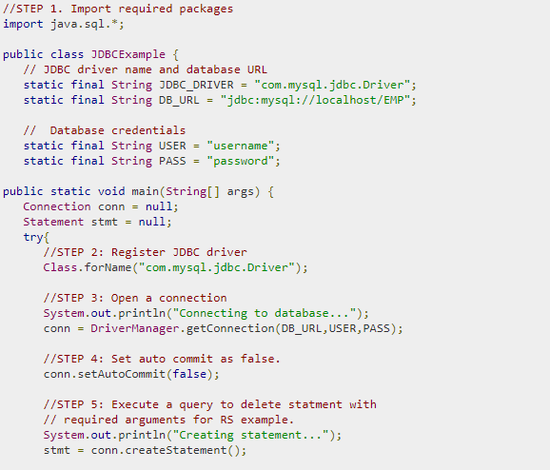
Example

Slide 35
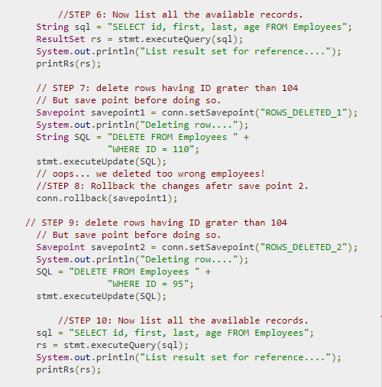
Example…

Slide 36
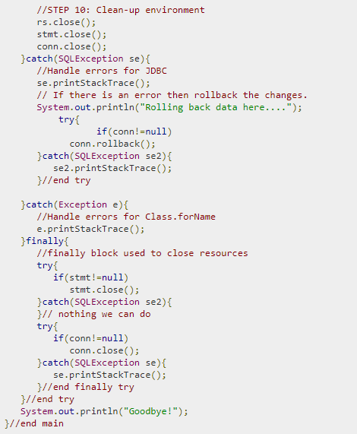
Example…

